Slide 1

QR Codes – The Hidden Technology Behind Scanning
Understanding how QR codes work and their impact on daily life.

Slide 2


Introduction to QR Codes
1
Quick Response
2
2D Barcode
3
Versatile Data Storage
QR stands for Quick Response.
Stores data in a square pattern.
Text, URLs, payment details, and more.

Slide 3

History of QR Codes
1994
1
Invented by Denso Wave (Toyota, Japan).
2
Automotive Beginnings
Tracking car parts in manufacturing.
Smartphone Era
3
Popularity with smartphones and payments.

Slide 4
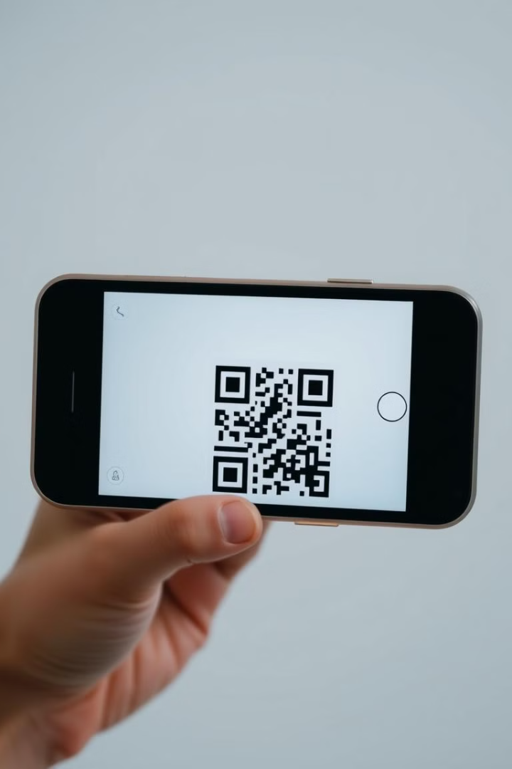



How QR Codes Work?
Camera Detects
Camera detects the QR pattern.
Pattern to Data
Scanner converts to binary data.
Information Extracted
Opens stored URL, text, etc.

Slide 5

Structure of a QR Code
Finder Patterns
Alignment Pattern
Timing Pattern
Error Correction
Helps scanners recognize the code.
Corrects scanning distortions.
Synchronizes data reading.
Allows scanning even if damaged.

Slide 6

Types of QR Codes
Static QR Codes
Fixed information, cannot be changed.
Dynamic QR Codes
Editable and trackable for payments/marketing.

Slide 7

How to Create & Scan a QR Code
Visit Website
www.qr-code-generator.com
Enter Data
Text or URL.
Download & Scan
Use a mobile camera.

Slide 8

Security Risks & Misuse
Fake QR Codes
Fraudulent Payments
Phishing attacks.
Steal money.
Malicious Links
Install malware.
Verify source, use security apps, and avoid random scans.

Slide 9




Future of QR Codes
NFC vs. QR
3D QR Codes
AR Integration
Will NFC replace QR?
Compact and tamper-resistant.
Interactive experiences.

Slide 10

Thank You
Thank You for Your Attention!
Any Questions?

